Slide 1

Direct Memory Access
Lecture 4
Introduction to ARM Processor
This material is developed by IMTSchool for educational use only
All copyrights are reserved

Slide 2

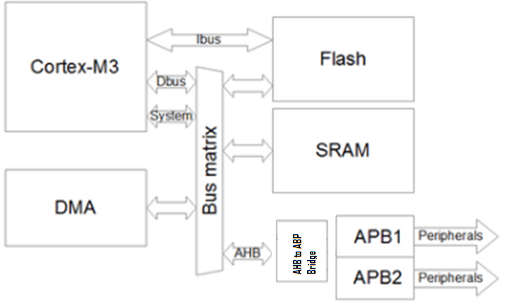
Direct Memory Access

Slide 3
Features
1- Very Speed data transfer between:
  Memory To Memory
  Memory To Peripheral
  Peripheral To Peripheral
2- Data is transferred without any actions of the CPU, which keeps the CPU resources free for other operations
3- DMA in STM32F103 medium density controller has 7 different channels
4- Priorities of the channels is programmable in 4 levels:
  Very High
  High
  Medium
  Low

Slide 4
Features
1- when the CPU and DMA are targeting the same destination (memory or peripheral). The bus matrix implements round-robin scheduling, thus ensuring at least half of the system bus bandwidth (both to memory and peripheral) for the CPU.
2- the peripheral sends a request signal to the DMA Controller. The DMA
controller serves the request depending on the channel priorities. As soon as the DMA Controller accesses the peripheral, an Acknowledge is sent to the peripheral by the DMA Controller. The peripheral releases its request as soon as it gets the Acknowledge from the DMA Controller. Once the request is deasserted by the peripheral, the DMA Controller release the Acknowledge. If there are more requests, the peripheral can initiate the next transaction.
3- Each channel can handle DMA transfer between a peripheral registerlocated at a fixed address and a memory address. The amount of data to be transferred (up to 65535) is programmable. The register which contains the amount of data items to be transferred is decremented after each transaction

Slide 5
Arbiter
The arbiter manages the channel requests based on their priority and launches the
peripheral/memory access sequences.
The priorities are managed in two stages:
• Software: each channel priority can be configured in the DMA_CCRx register. There
are four levels:
– Very high priority
– High priority
– Medium priority
– Low priority
• Hardware: if 2 requests have the same software priority level, the channel with the
lowest number will get priority versus the channel with the highest number. For
example, channel 2 gets priority over channel 4.

Slide 6
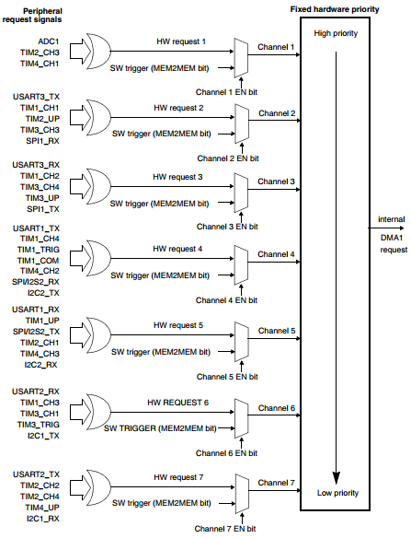
HW channels

Slide 7
Circular Mode
When circular mode is activated, the number of data to be transferred is automatically
reloaded with the initial value programmed during the channel configuration phase, and the DMA requests continue to be served

Slide 8
Memory To Memory
The DMA channels can also work without being triggered by a request from a peripheral. This mode is called Memory to Memory mode. If the MEM2MEM bit in the DMA_CCRx register is set, then the channel initiates transfers as soon as it is enabled by software by setting the Enable bit (EN) in the DMA_CCRx register. The transfer stops once the DMA_CNDTRx register reaches zero. Memory to Memory mode may not be used at the same time as Circular mode.

Slide 9
External Interrupt Controller

Slide 10
External Interrupt Controller

Slide 11
External Interrupt Controller

Slide 12
External Interrupt Controller

Slide 13
External Interrupt Controller

Slide 14
External Interrupt Controller

Slide 15


www.imtschool.com
ww.facebook.com/imaketechnologyschool/
This material is developed by IMTSchool for educational use only
All copyrights are reserved

